Slide 1
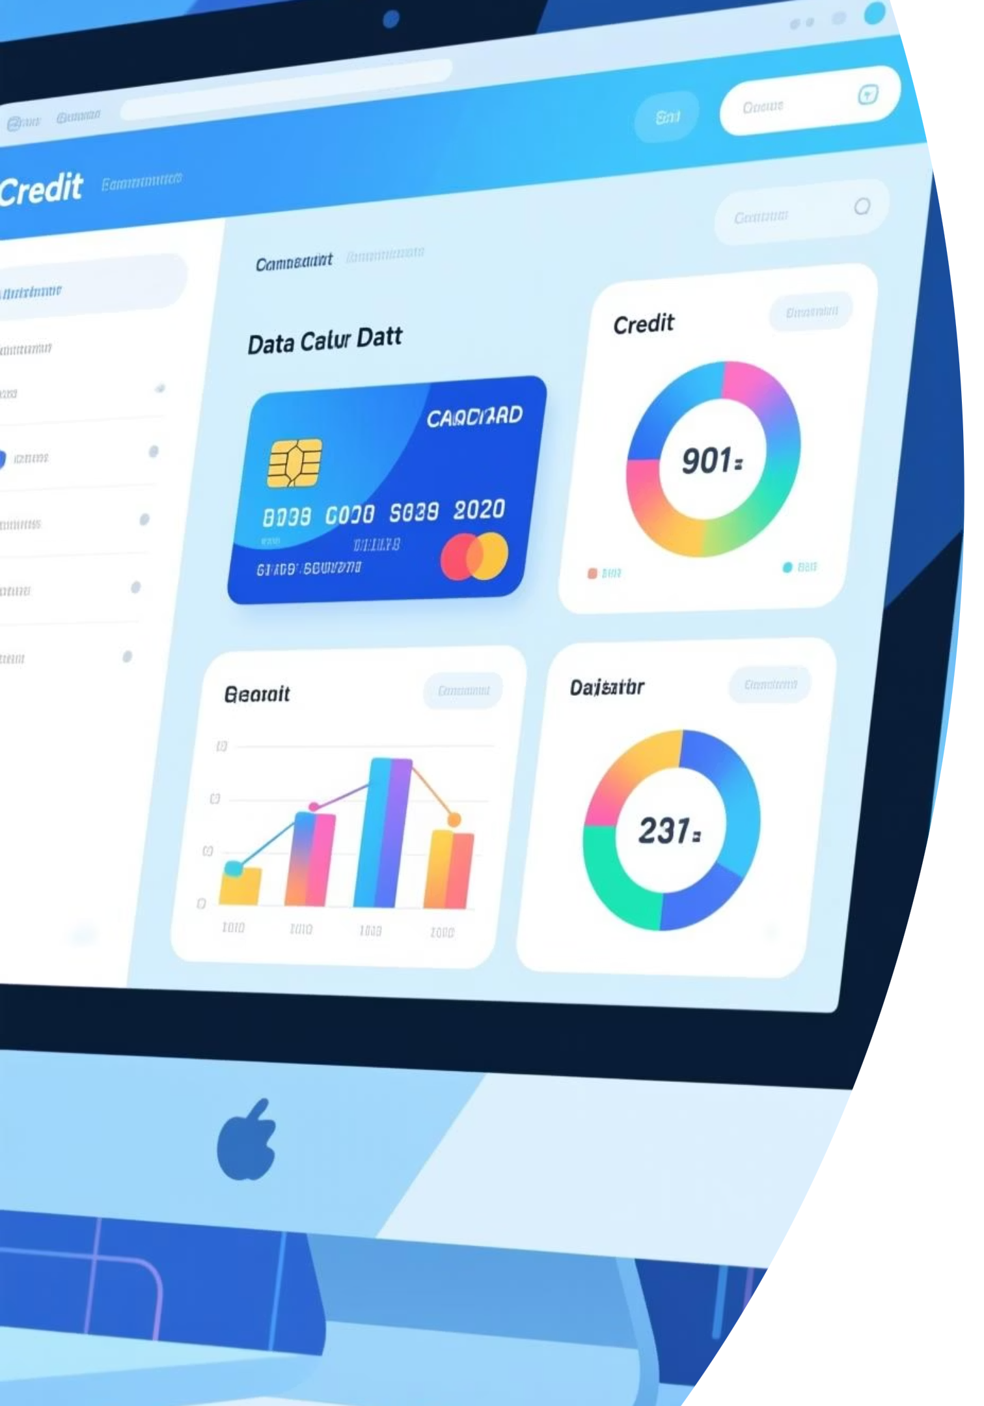
Credit Card Weekly Dashboard
Real-time insights into key performance metrics and trends for effective credit card operations monitoring

Slide 2

Data Foundation
MySQL Database Architecture
Power BI Integration
Seamless connection between MySQL and Power BI enables automated data refresh and real-time reporting capabilities
Credit Card Customer Data
Credit Card Transaction Data
SQL-based extraction & filtering

Slide 3

Data Processing & KPI Engineering
01
02
Power Query Transformation
Relationship Modeling
Data cleaning, normalization, and quality assurance
Connected customer and transaction tables with optimized joins
03
04
DAX Measures
Dimensional Analysis
Advanced calculations for revenue, interest, activation & delinquency rates
Segmentation by gender, state, card type, and expense categories

Slide 4
Dashboard Performance Overview
$57M
$8M
667K
57.5%
Total Revenue
Interest Earned
Transactions
Activation Rate
Consolidated across all card types
Additional revenue stream
High volume activity
Strong customer engagement
6.06%
Delinquent Rate
Risk monitoring indicator
Revenue Distribution Insights
By Gender
By Geography
Male customers: $31M (54%)
TX, NY, CA drive 68% of total revenue
Female customers: $26M (46%)
Blue & Silver Cards
Top Transaction Mode
Expense Categories
93% of revenue
Swipe: $36M
Bills, Entertainment, Fuel, Grocery
Dominant product categories
Chip: $17M | Online: $4M

Slide 5





Week 53 Performance Surge
Revenue Jump
Customer Expansion
Transaction Volume
28.8% WoW increase
Significant growth in active customer base and engagement
Notable increase in total transaction count across all channels
Strong year-end performance on December 31st
TX, NY, and CA maintain dominance, collectively driving the majority of revenue growth during this peak period

Slide 6




Impact & Strategic Value
Enhanced Storytelling
Advanced Power BI visualizations transform complex data into actionable insights for stakeholders
Technical Excellence
Demonstrated proficiency in SQL integration, ETL processes, and dynamic KPI analysis
Real-Time Operations
Enabled continuous performance tracking for strategic credit card portfolio management decisions

